Slide 1
Chapter 13
Chapter 13
Wired LANs: Ethernet
Wired LANs: Ethernet

Slide 2
Chapter 13: Outline
13.1 Ethernet Protocol
13.2 Standard Ethernet
13.3 Fast Ethernet
13.4 Gigabit Ethernet
13.5 10Gigabit Ethernet

Slide 3
Chapter 13: Objective
The first section discusses the Ethernet protocol in general. It explains that IEEE Project 802 defines the LLC and MAC sub-layers for all LANs including Ethernet. The section also lists the four generations of Ethernet.
The second section discusses the Standard Ethernet. The section first describes some characteristics of the Standard Ethernet. It then discusses the addressing mechanism, which is the same in all Ethernet generations. The section next discusses the access method, CSMA/ CD, which we discussed in Chapter 12. The section then reviews the efficiency of the Standard Ethernet. It then shows the encoding and the implementation of this generation.

Slide 4
Chapter 13: Objective
The third section describes the Fast Ethernet, the second generation, which can still be seen in many places. The section first describes the changes in the MAC sublayer. The section then discusses the physical layer and the implementation of this generation.
The fourth section discusses the Gigabit Ethernet, with the rate of 1 gigabit per second. The section first describes the MAC sublayer. It then moves to the physical layer and implementation.
The fifth section touches on the 10 Gigabit Ethernet. This is a new technology that can be used both for a backbone LAN or as a MAN (metropolitan area network).

Slide 5
13.1 Ethernet Protocol
LAN(Local Area Network)
  used for the sharing of resources
  used medium access method to share the media
  Linked to a WAN or Internet.
Different type of LAN in the 1980s and 1990s
  Ethernet used CSMA/CD approach
  Token Ring, Token Bus, FDDI(fiber Distributed Data Interface) used the Token Passing approach
  Almost every LAN except Ethernet has disappeared.

Slide 6
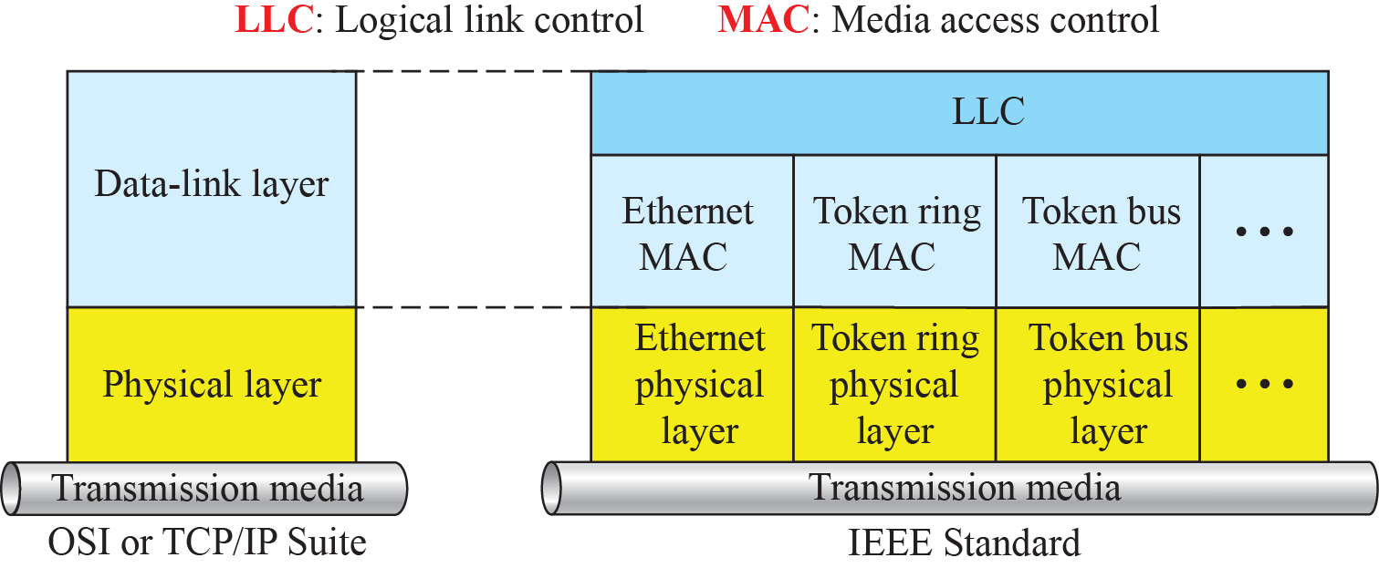
13.1.1 IEEE Project 802
Project 802
  IEEE started a project to set standards to enable intercommu-nication among equipment from a variety of manufacturers in 1985.
  It is specifying the functions of the physical layer and the data-link layer of major LAN protocols.
IEEE standard for LANs
802.2
802.3
802.4
802.5
802.11
Wireless

Slide 7
13.1.1 IEEE Project 802
LCC(Logical Link Control)
  It deals with Flow control, error control, and part of the framing
MAC(Media Access Control)
  It defines the specific access method for each LAN (Ethernet, Token ring, Token passing, …)
  Framing is handled in both the LLC and MAC sublayer.

Slide 8
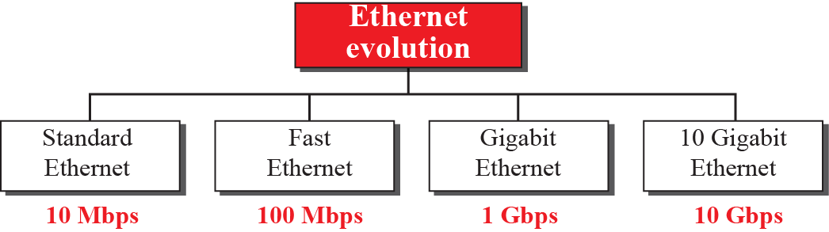
13.1.2 Ethernet Evolution
Ethernet
  The Ethernet LAN was developed in the 1970s by Robert Metcalfe and David Boggs.
  It has gone through four generations: Standard Ethernet (10 Mbps), Fast Ethernet (100 Mbps), Gigabit Ethernet (1 Gbps), and 10 Gigabit Ethernet (10 Gbps)

Slide 9
13.2 Standard Ethernet
Standard Ethernet
  Original Ethernet technology with the data rate of 10 Mbps is refer to as the Standard Ethernet.
    It uses CSMA/CD
  Connectionless Oriented Service
    There is no connection establishment or termination.
    Sender sends a frame whether a receiver is ready or not.
  Unreliable Service
    The corrupted frame is dropped by receiver, and sender do not know about it.

Slide 10
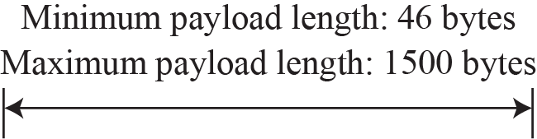
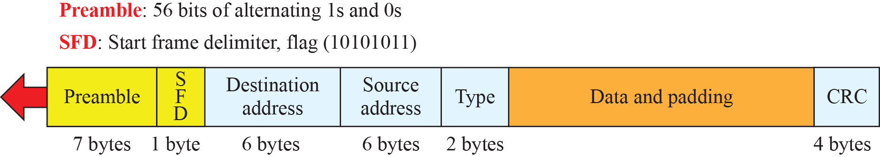
13.2.1 Frame of Standard Ethernet
Frame
  It is composed of 7 fields.
  The length of a frame is variable.
Ethernet Frame

Slide 11
13.2.1 Frame of Standard Ethernet
Frame Format
  Preamble
    It alerts the receiving system to the incoming frame.
    The pattern provides only an alert and a timing pulse.
  Start Frame Delimiter(SFD)
    It signals the beginning of the frame.
    It warns that this is last chance of synchronization.
    The last 2 bits are 11 and alert that next field is destination address.
  Type
    It defines the upper layer protocol, and this protocol can be IP, ARP, OSPF, and so on.
  Data :
    If it is less than 46bytes, extra 0s need to be padded.
  CRC : CRC-32

Slide 12
13.2.1 Frame of Standard Ethernet
Frame Length
  Minimum length : 64Byte (512bit)
    Minimum length is required for the correct operation of CSMA/CD.
    Payload - 46Byte, Header – 18Byte
  Maximum length : 1,518Byte
    Maximum length is required for the size of buffer and prevention from monopolizing the medium.
    Payload - 1,500Byte,

Slide 13

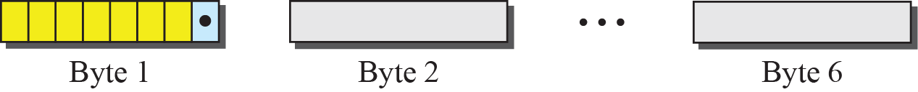
13.2.2 Addressing
Each station on an Ethernet network (such as a PC, workstation, or printer) has its own network interface card (NIC).
  The NIC provides with a link-layer address.
Ethernet Address
  is 6 bytes (48 bits), normally written in hexadecimal notation, with a colon between the bytes.
A3:34:45:1D:92:F1 – Multicast Address
A2:34:45:1D:92:F1 – Unicast Address

Slide 14
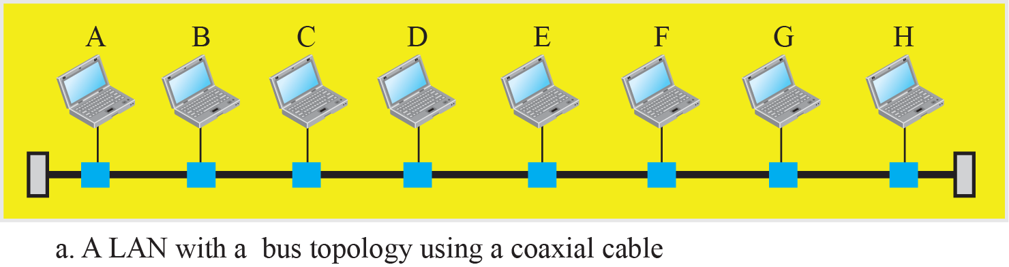
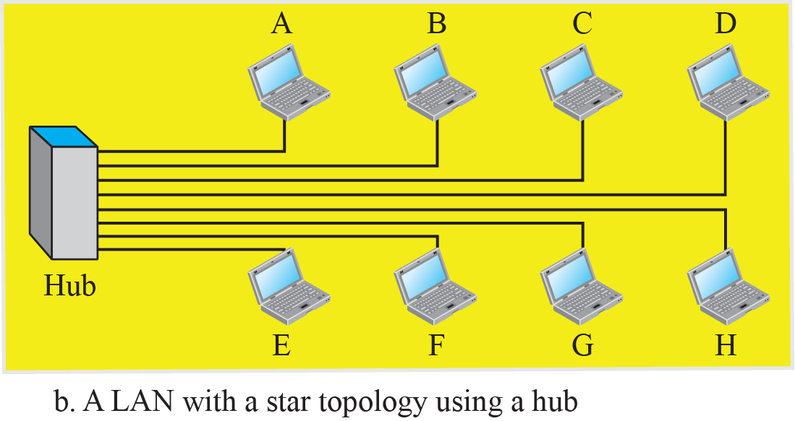
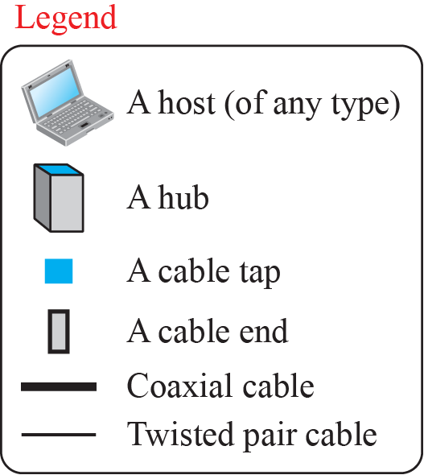
13.2.2 Addressing
Implementation of Standard Ethernet

Slide 15
13.2.3 Access Method
The network that uses the standard Ethernet protocol is a broadcast network
  We need to use an access method to control access to the sharing medium.
The standard Ethernet choose CSMA/CD with 1-persistent method.
How this method works for the Ethernet protocol?

Slide 16
13.2.3 Access Method
Assume station A has a frame to send to D.
  Station A first should check whether any other is sending (carrier sensing).
    A measures the level of energy on the medium.
  If there is no signal, it starts sending its frame.
    A saves a copy of the frame in buffer
    If signal level is not zero, A continuously monitors the medium.
  If A does not sense the collision before sending 512bits, there must have been no collision.
    If A has sensed the collision before sending 512bits, both stations should refrain from sending and keep the frame in buffer for resending.

Slide 17
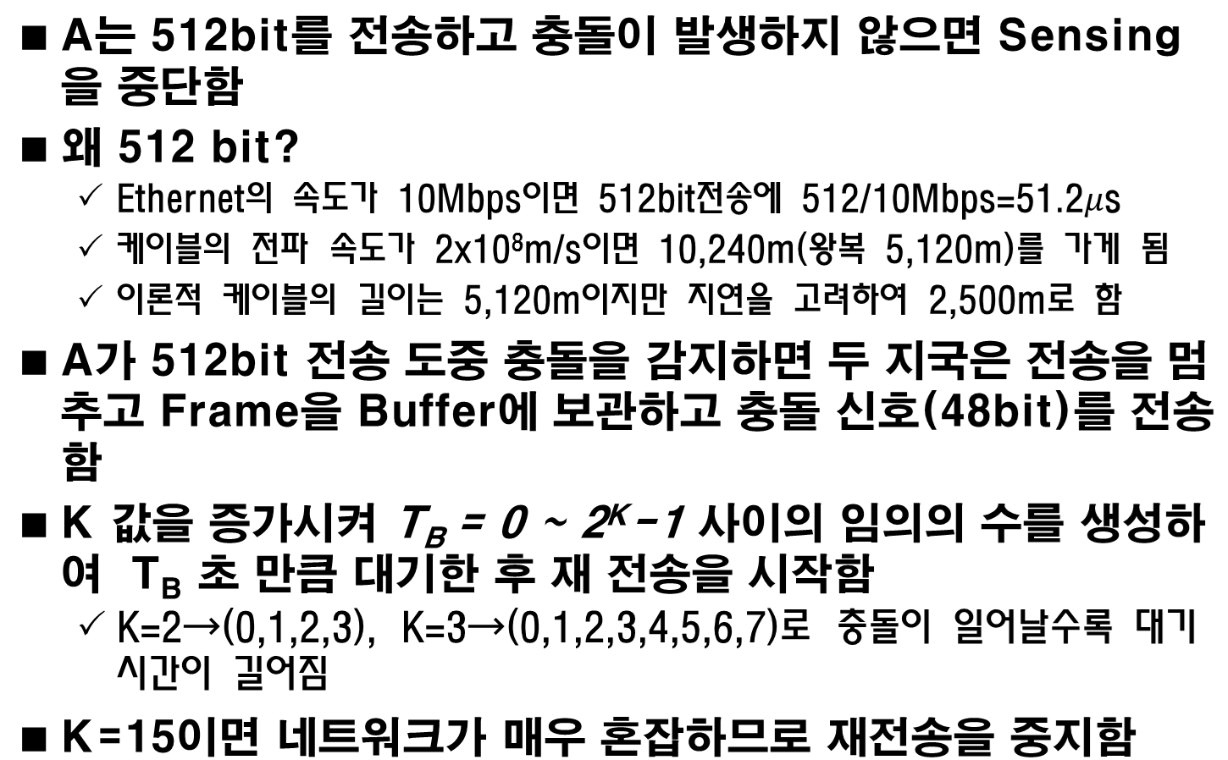
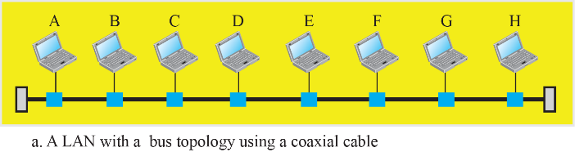

13.2.3 Access Method

Slide 18
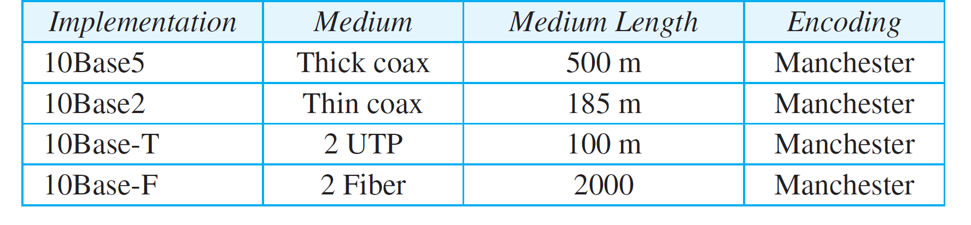
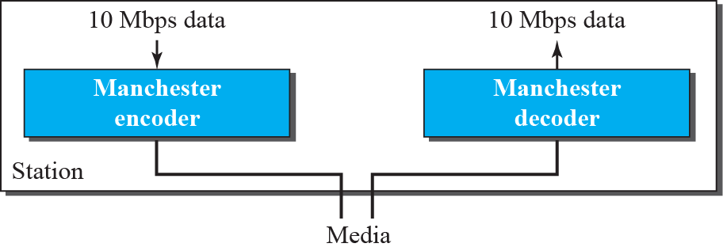
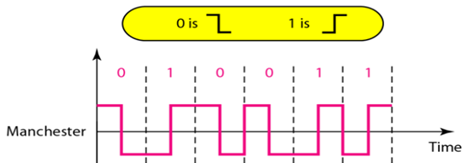
13.2.5 Implementation
Standard Ethernet implementations
Encoding in a Standard Ethernet

Slide 19
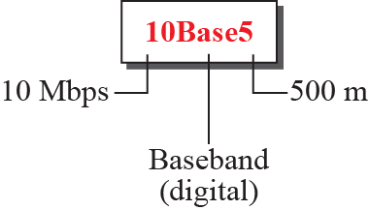
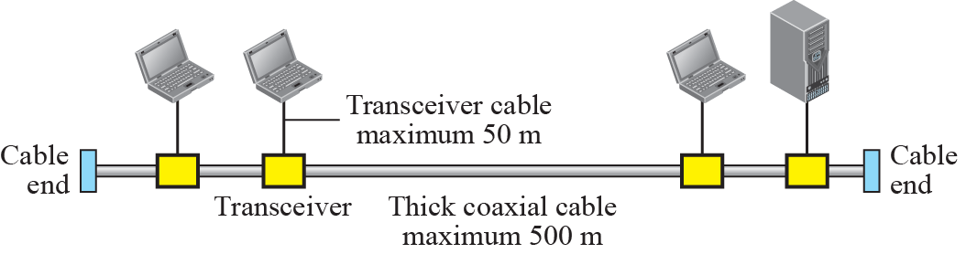
13.2.5 Implementation
10Base5 implementation

Slide 20
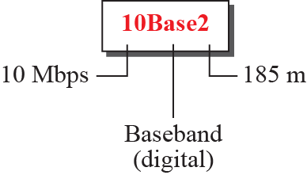
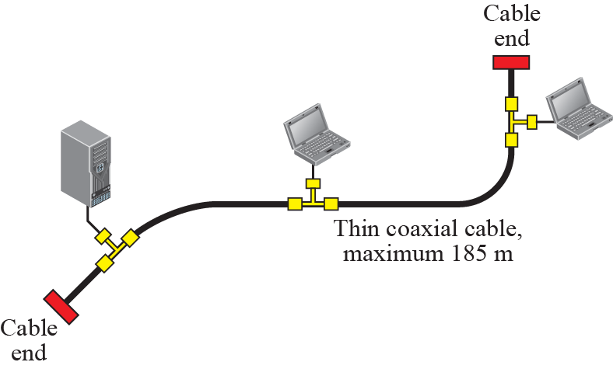
13.2.5 Implementation
10Base2 implementation

Slide 21
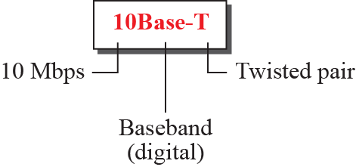
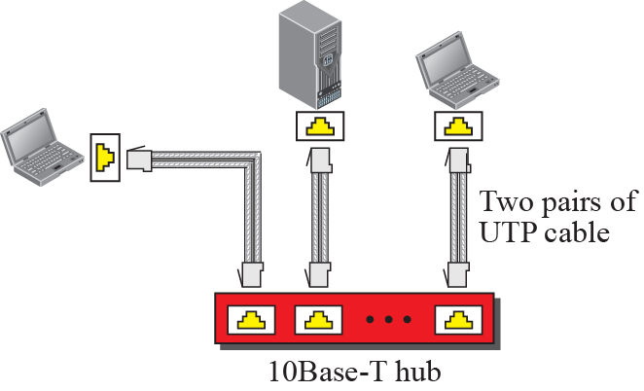
13.2.5 Implementation
10Base-T implementation

Slide 22
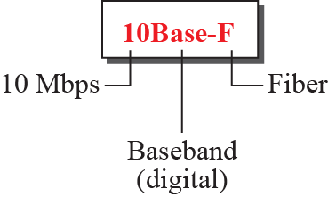
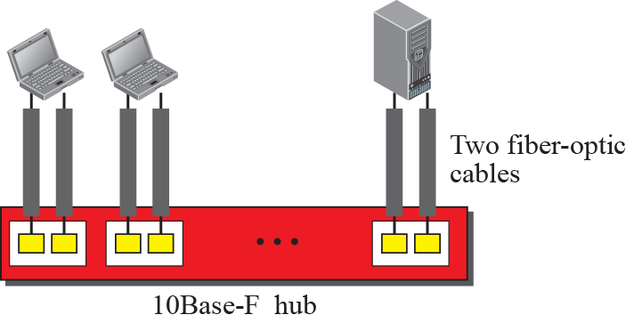
13.2.5 Implementation
10Base-F implementation

Slide 23
13.2.6 Changes in the Standard
Before we discuss higher-rate Ethernet protocols, we need to discuss the changes that occurred to the 10-Mbps Standard Ethernet.
These changes actually opened the road to the evolution of the Ethernet to become compatible with other high-data-rate LANs.

Slide 24
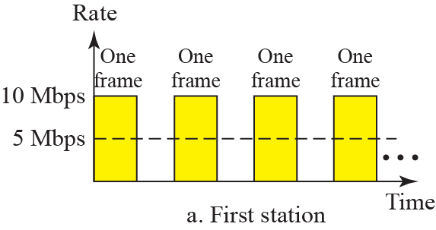
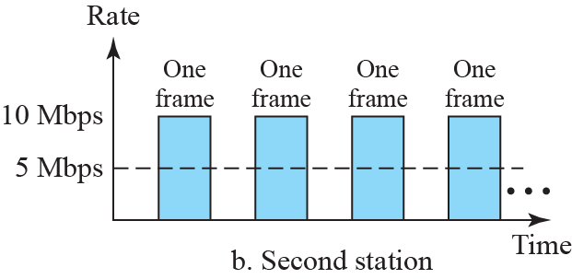
13.2.6 Changes in the Standard
Sharing bandwidth
  The total capacity (10Mbps) is shared among all stations.
  In the case of two station

Slide 25
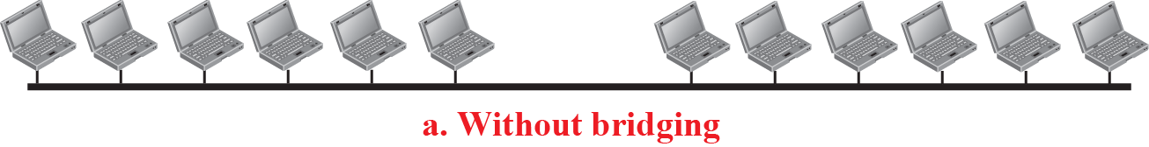
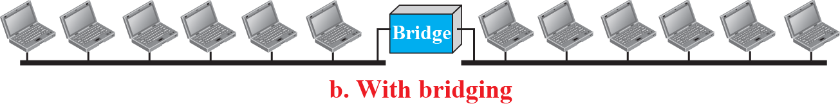
13.2.6 Changes in the Standard
A network with and without bridging

Slide 26
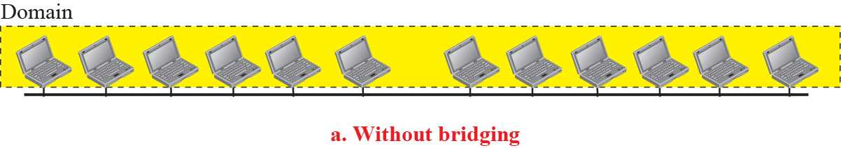
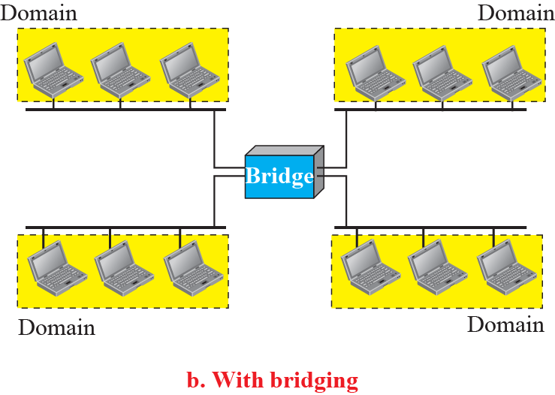
13.2.6 Changes in the Standard
Bridge separates collision domains
  They raise the bandwidth

Slide 27
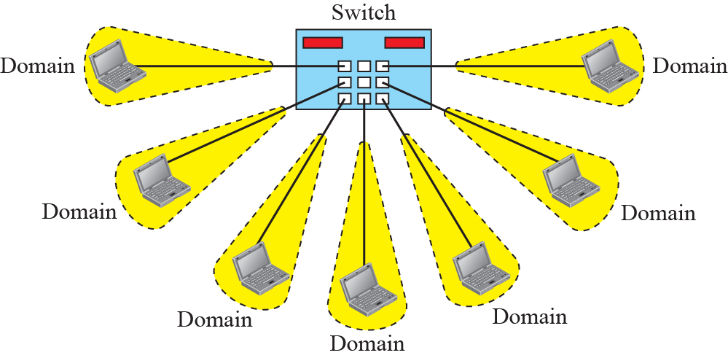
13.2.6 Changes in the Standard
Switched Ethernet
  A layer-2 switch is N-port bridge with faster handling of the packets.
  It is big step to faster Ethernet.

Slide 28
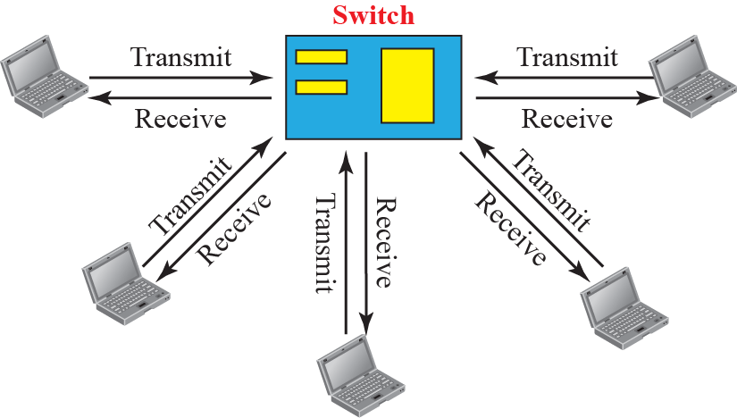
13.2.6 Changes in the Standard
Full-duplex Switched Ethernet
  10Base-T is full-duplex communication.
  No need for CSMA/CD
    There are no longer carrier sensing and collision detection
  MAC Control Sublayer
    It is added between LLC and MAC to provide for error and flow control.

Slide 29
13.3 Fast Ethernet
Fast Ethernet
  In the 1990s, Ethernet made a big jump by increasing the transmission rate to 100Mbps.
  The designers of the Fast Ethernet needed to make it compatible with the Standard Ethernet.
    The MAC sublayer was left unchanged.
    The transmission rate had to be changed.
    Keep the same 48-bit address.
    Keep the same frame format.

Slide 30
13.3.1 Access Method
The proper operation of the CSMA/CD depends on the transmission rate, the minimum size of the frame, and the maximum network length.
  If we want to keep the minimum size of the frame, the maximum length of the network should be changed.
If the minimum frame size is still 512 bits, and it is transmitted 10 times faster, the collision needs to be detected 10 times sooner.
  The maximum length of the network should be 10 times shorter (the propagation speed does not change).

Slide 31
13.3.1 Access Method
To be able to handle a 100 Mbps data rate, several changes need to be made at the physical layer.
  Drop the bus topology, use a passive hub and star topology.
    The maximum size of the network is 250 meters.
  Use a link-layer switch with a buffer to store frames and a full-duplex connection.
Auto-negotiation
  It allows two devices to negotiate the mode or data rate of operation.

Slide 32
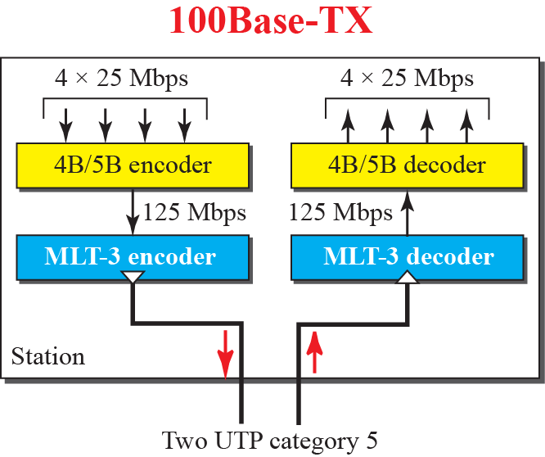
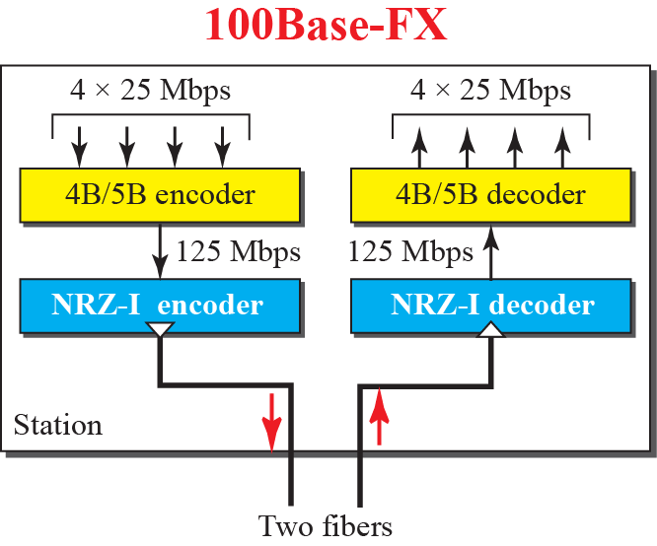
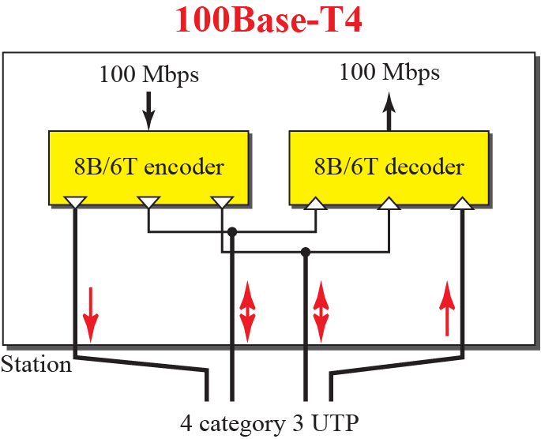
13.3.2 Physical Layer
Encoding for fast Ethernet

Slide 33
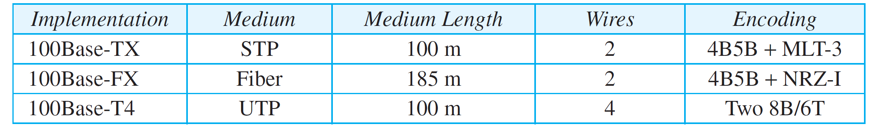
13.3.2 Physical Layer
Summary of Fast Ethernet implementations

Slide 34
13.4 Gigabit Ethernet
The need for an even higher data rate resulted in the design of the Gigabit Ethernet Protocol (1000 Mbps).
The goals of the Gigabit Ethernet were to upgrade the data rate to 1Gbps.
  Keep the 48-bit address length
  Keep the same frame format
  Keep the maximum and minimum frame length.

Slide 35
13.4.1 MAC Sublayer
A main consideration in the evolution of Ethernet was to keep the MAC sublayer untouched.
  However, to achieve a data rate of 1Gbps, this was no longer possible.
Two distinctive approaches for medium access:
  half-duplex
  full-duplex - Almost all implementations of Gigabit Ethernet

Slide 36
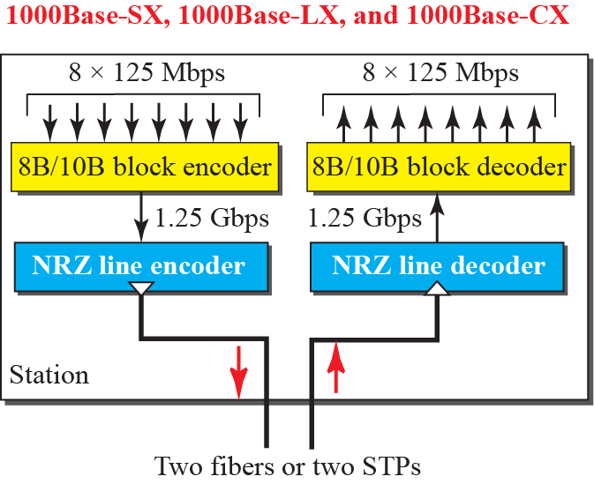
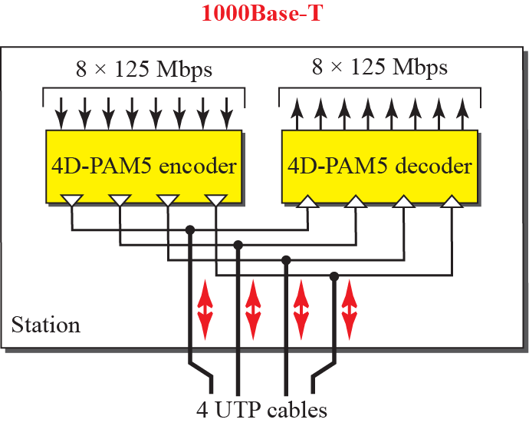
13.4.2 Physical Layer
The physical layer in Gigabit Ethernet is more complicated than that in Standard or Fast Ethernet.

Slide 37
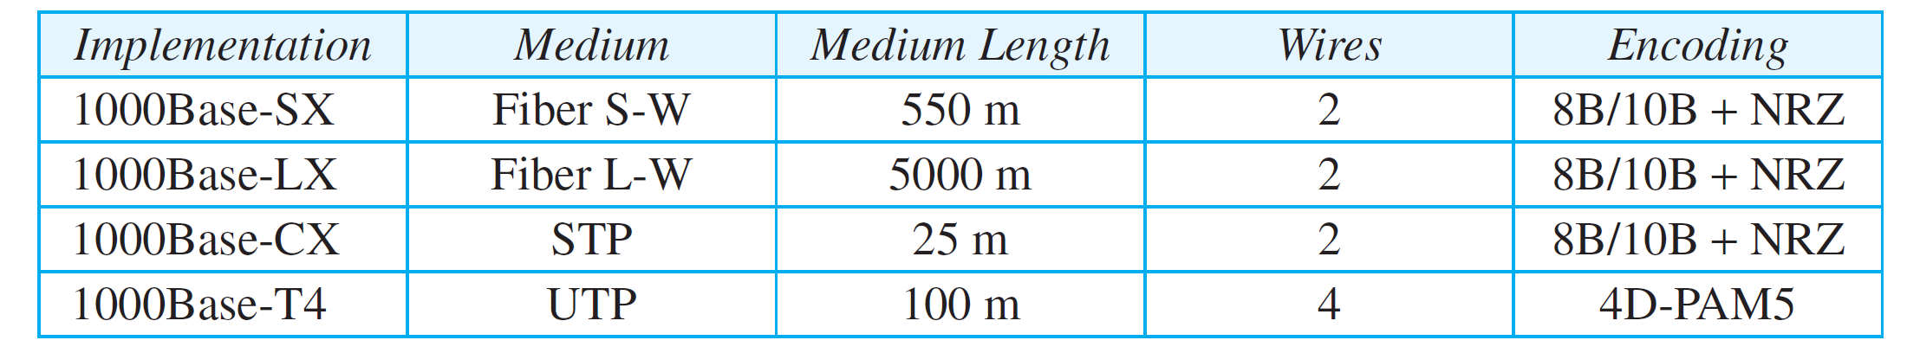
13.4.2 Physical Layer
Summary of Gigabit Ethernet implementations
  1000BASE-SX is an optical fiber Gigabit Ethernet standard over multi-mode fiber.
  1000BASE-LX is an optical fiber Gigabit Ethernet standard over single-mode fiber.
  1000BASE-CX is an initial standard for Gigabit Ethernet connections using balanced shielded twisted pair.
  1000BASE-T is a standard for Gigabit Ethernet over copper wiring.

Slide 38
13.5 10-Gigabit Ethernet
In recent years, there has been another look into the Ethernet for use in MAN (Metropolitan Area Network).
  The idea is to extend the technology, the data rate, and the coverage distance.
  The IEEE committee called it Standard 802.3ae.
10-Gigabit Ethernet defines only full-duplex point-to-point links which are generally connected by network switches.
  There is no need for contention.
  CSMA/CD is not used in 10 Gigabit Ethernet.

Slide 39
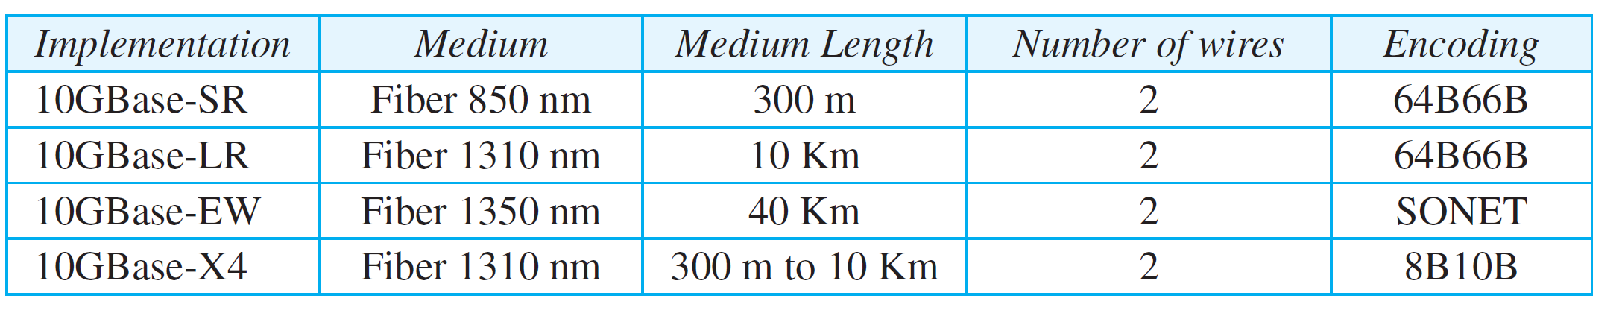
13.5.1 Implementation
Four implementations are the most common:
  10GBase-SR (Short Range) is a port type for multi-mode fiber.
  10GBase-LR (Long Range) is a port type for single-mode fiber.
  10GBase-EW (Extended Range) is a port type for single-mode fiber
  10GBase-CX4 was the first 10G copper standard.

Slide 40
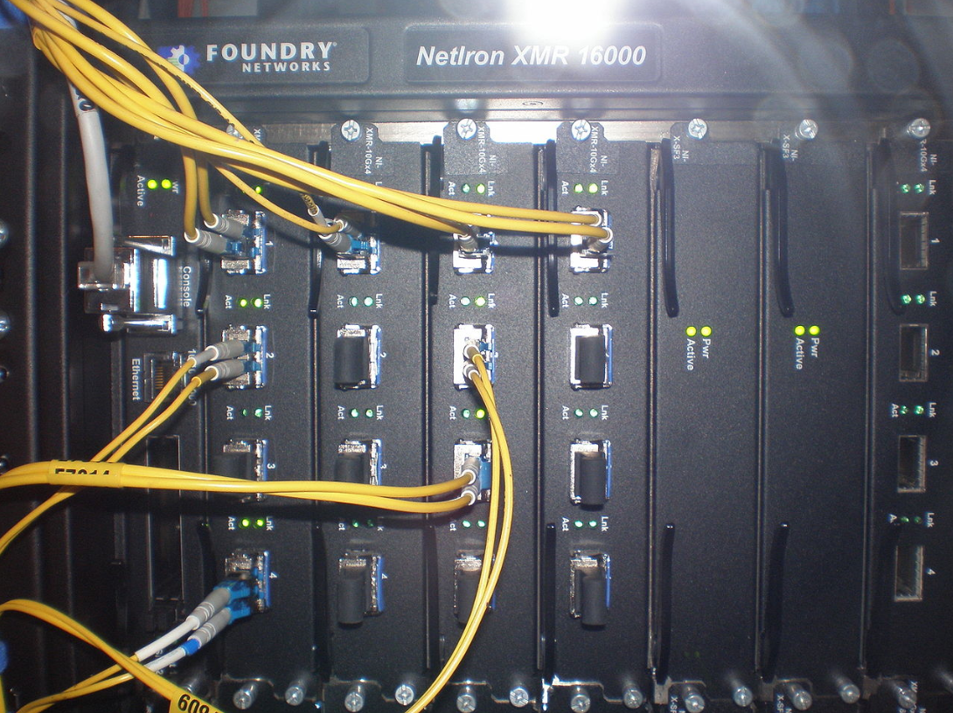
13.5.1 Implementation
Networks router with 10 Gigabit Ethernet optical interfaces.
  The yellow cables are single-mode duplex fiber optic connections.

Slide 41
13.6 Summary
The IEEE 802.3 defines 1-persistent CSMA/CD as access method for 1st Generation 10Mbps Ethernet.
The data-link layer of Ethernet consists of the LLC and MAC sublayer.
  The MAC sublayer is responsible for the operation of CSMA/CD method and framing.
Each station on an Ethernet has 48-bit address.
The minimum frame length for 10Mbps Ethernet is 64bytes; the Maximum is 1518 bytes.
A bridge can increase the bandwidth and separate the collision domains on an Ethernet LAN.

Slide 42
13.6 Summary
Fast Ethernet
  Fast Ethernet increased the speed to 100Mbit/s.
  Fast Ethernet needed to be compatible with the Standard Ethernet.
Gigabit Ethernet
    increasing the speed to 1000Mbit/s.
    Initially, it was deployed in high-capacity backbone network links (for instance, on a high-capacity campus network).
    Using optical fiber (1000BASE-X), twisted pair cable (1000BASE-T), or shielded balanced copper cable (1000BASE-CX).
10-Gigabit Ethernet
  Ethernet for use in MAN (Metropolitan Area Network).

